Slide 1

Cathode High Voltage Tubing Radon Emanation Measurement
H. Ryott Glayzer
SDSMT Undergraduate Research Assistant
February 2023

Slide 2
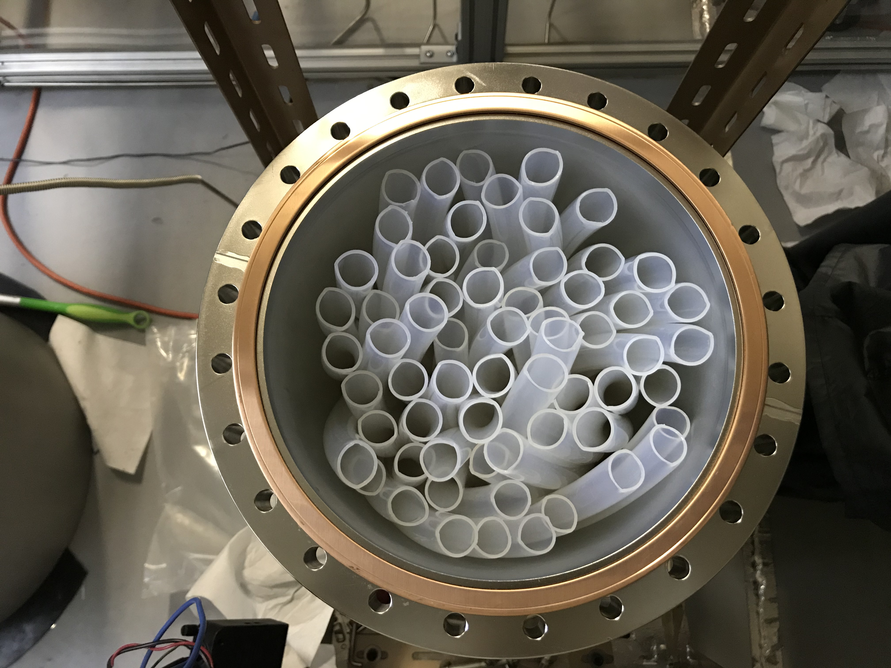
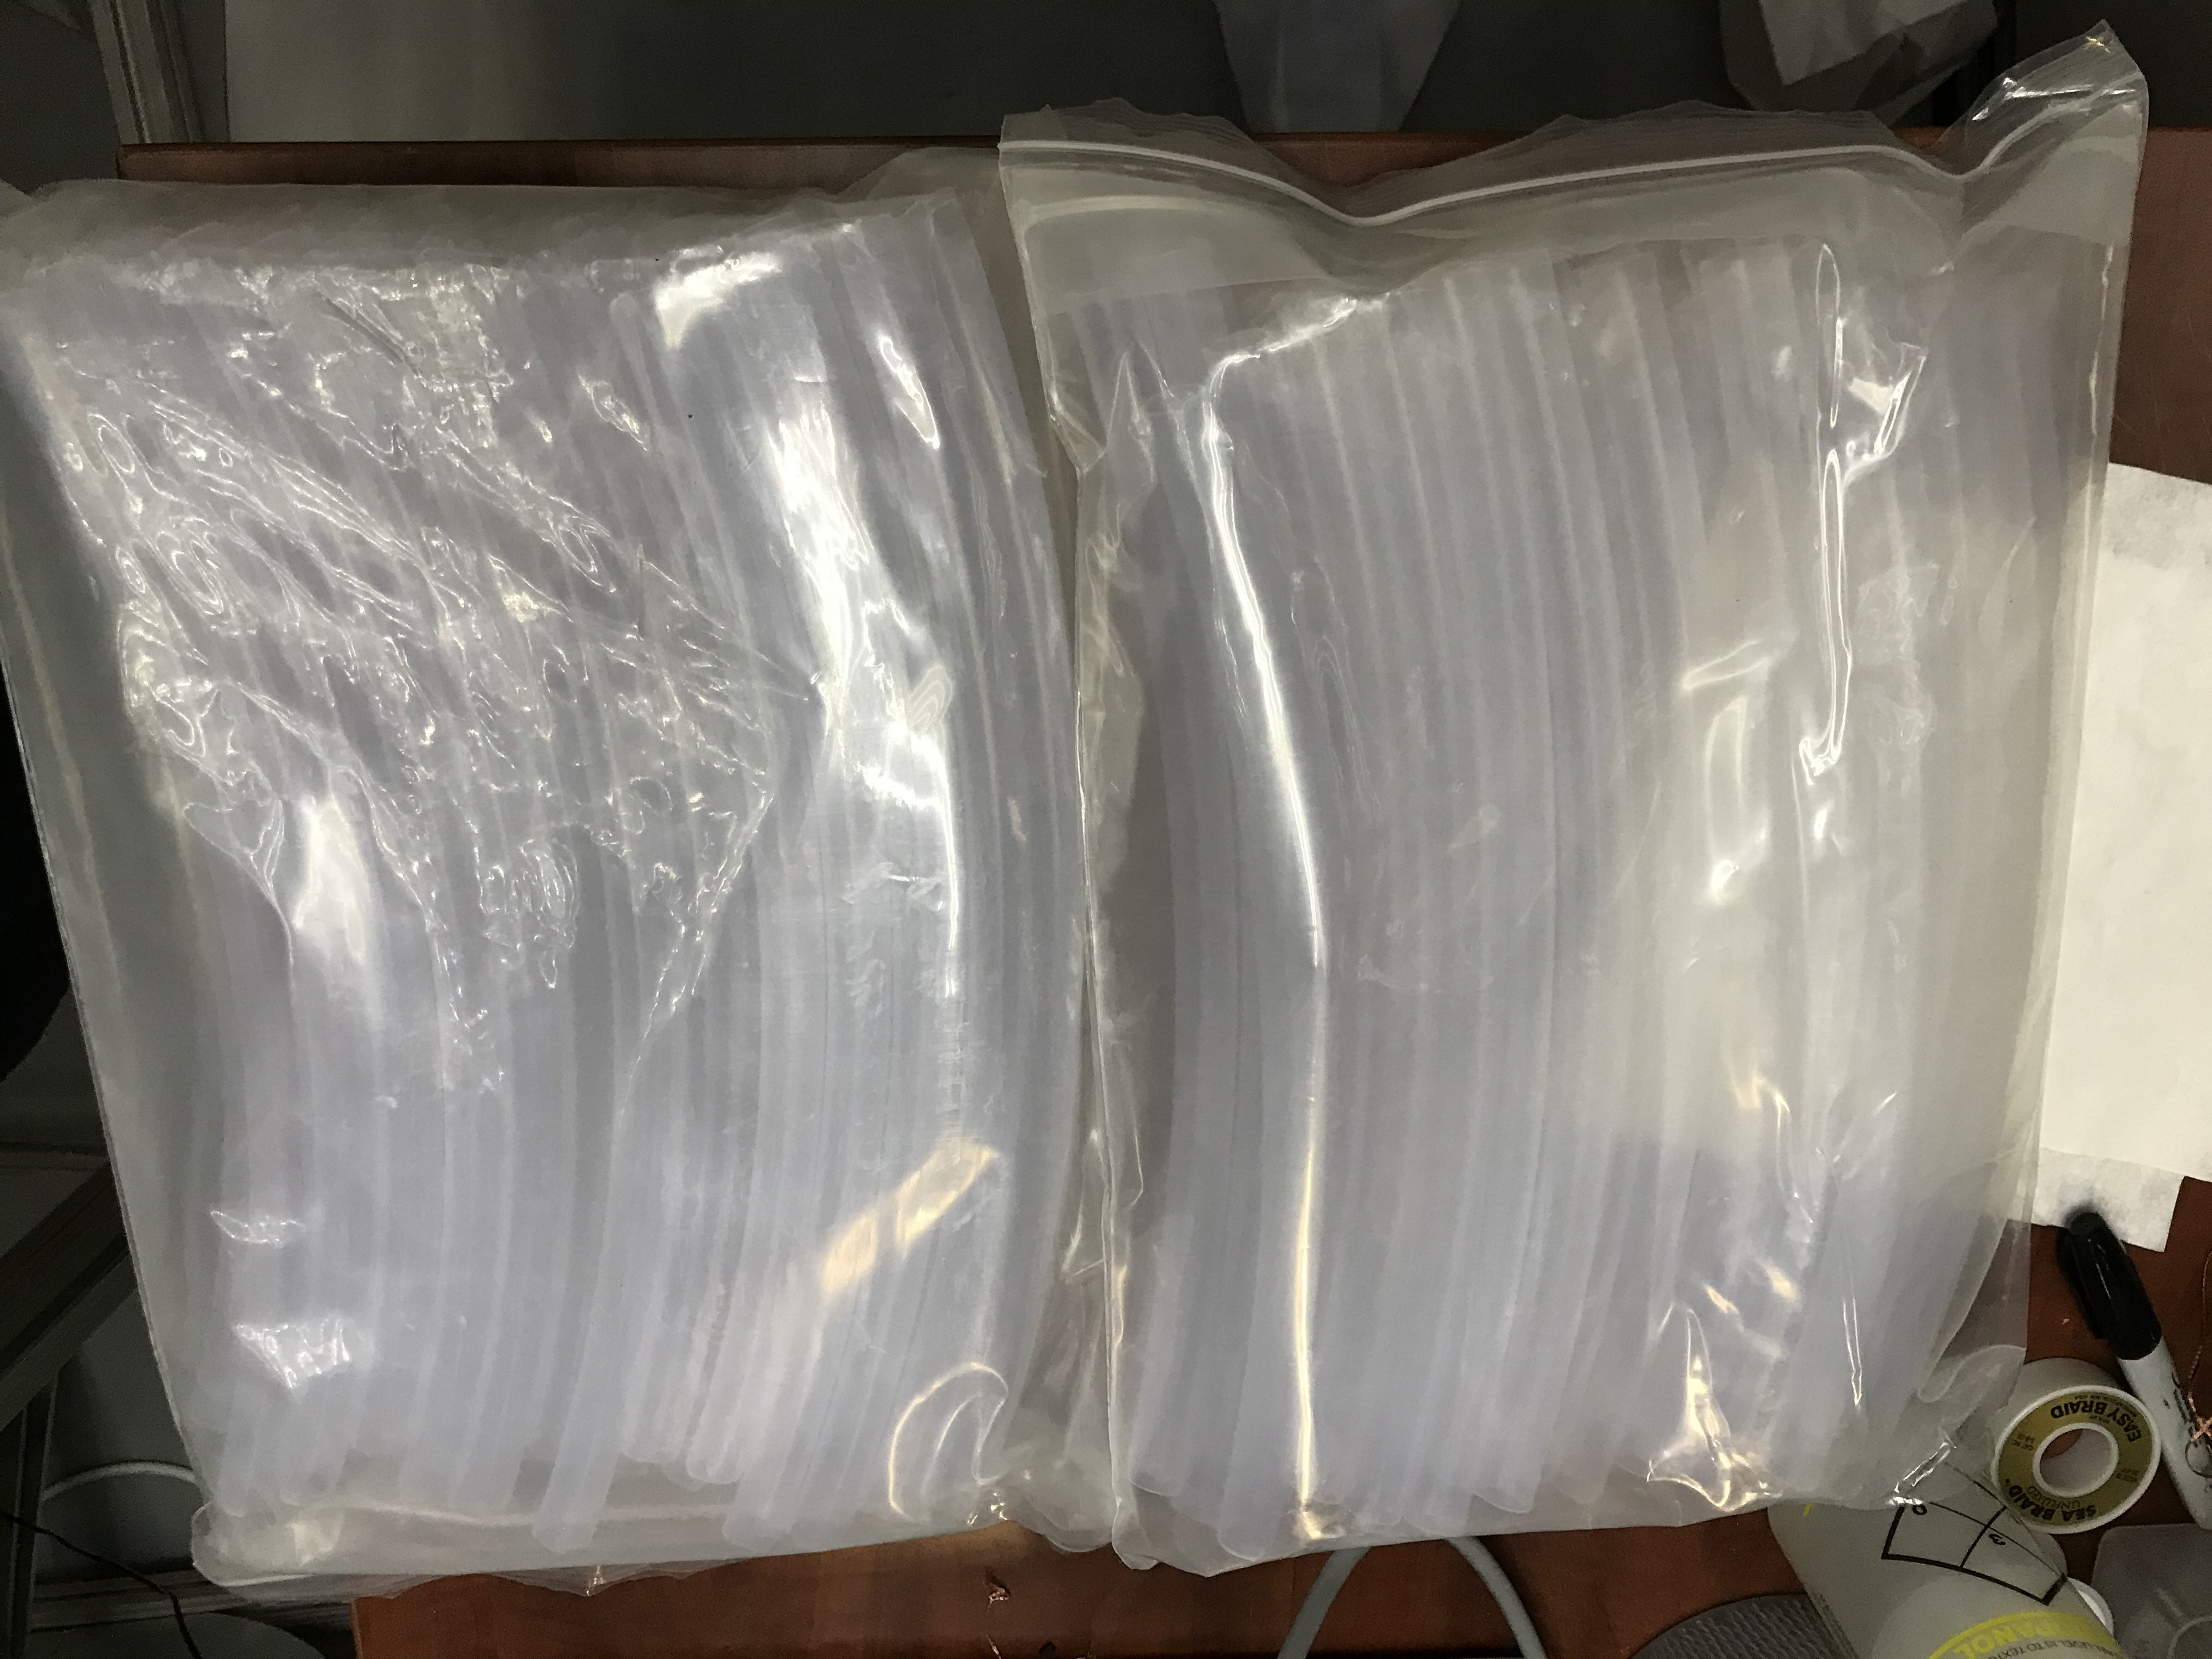
Sample
LZ Tubing before being placed in small emanation chamber.
LZ Tubing after being placed in the Small Emanation Chamber
2

Slide 3
Overview
The Tubing was emanated 3 times throughout October and November 2020.
Gain Correction for the first transfer was based off Po-214 counts, since there was a large overlap between the Po-218 and Po-210 counts. However. Gain correction on the second and third transfers were based off of Po-210 counts
64 Pieces of tubing, each approximately 15.5” in length were emanated.
The sample was massed 2023-02-15 at 4,266 ± 4 g
Measurements indicated an emanation rate of 0.11 ± 0.1 mBq
  This is a negligible fraction of the allowed by the LZ Experiment ^{[1]}
[1]. LZ Assay and Cleanliness, p. 41
3

Slide 4
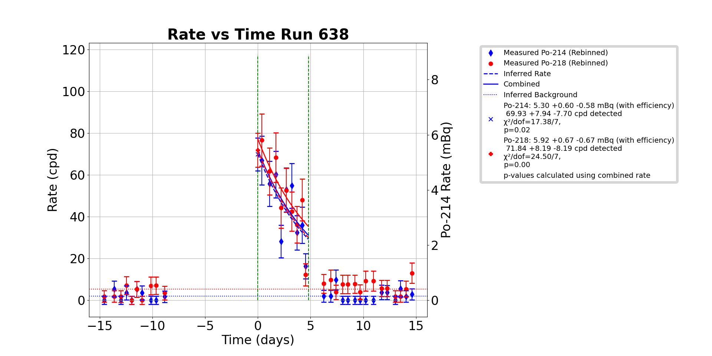
First Emanation (Oct. 28 – Nov. 5)
Emanated at 98.3 Torr. This is high enough to include recoil emanation from all surfaces.
Rate and Gain Correction based off of Po-214 counts due to low energy resolution between Po-210 and Po-218 peaks.
Po-214 counts indicate a rate of mBq
Data from the pre-background emanation was omitted from analysis because gain shift caused noise levels to interfere with Po-210 counts.
The sample was probably still degassing room air so this measurement was not used in the conclusions

Slide 5
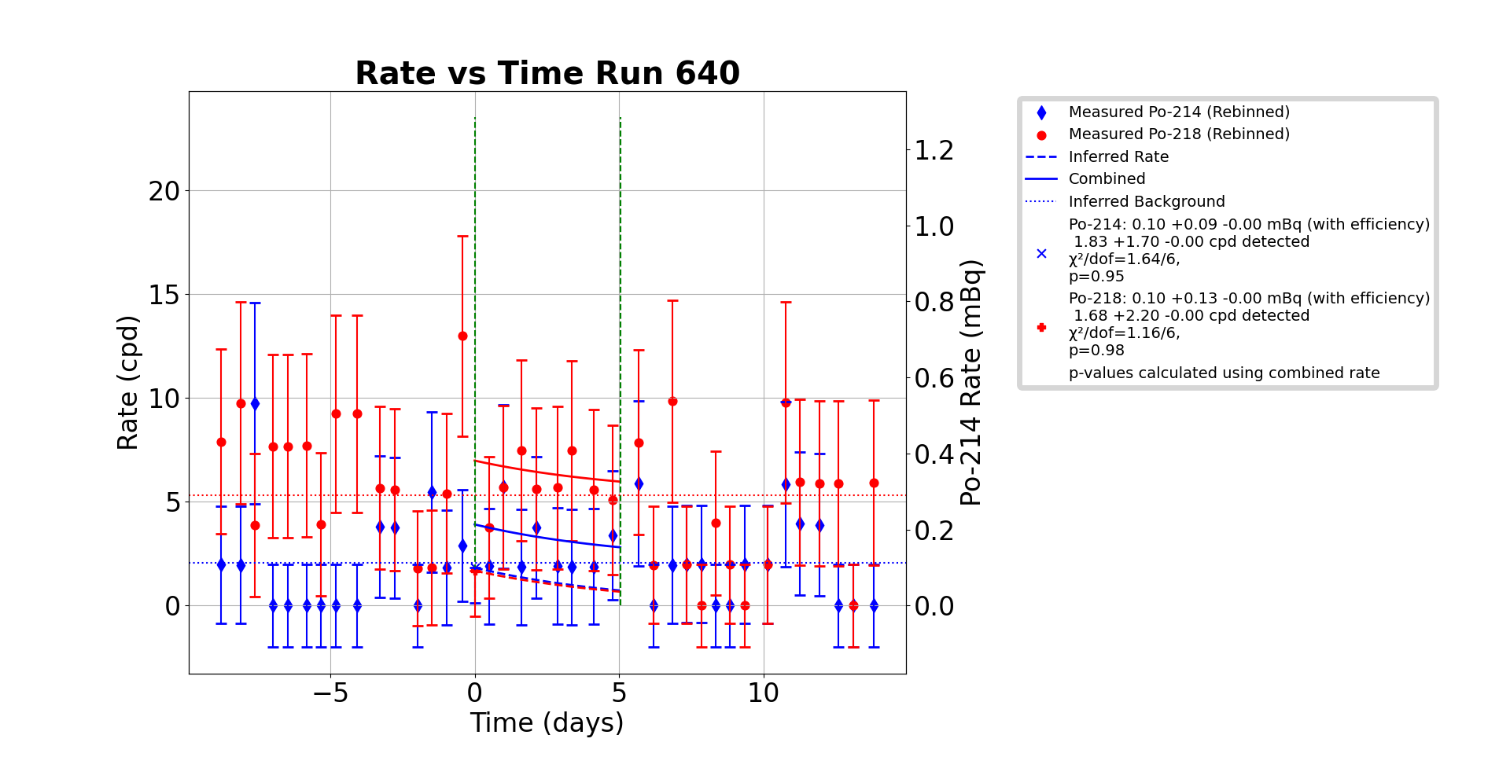
Second Emanation (Nov. 5 - 11)
Emanated at 99.0 Torr. This is high enough to include recoil emanation from all surfaces.
Analysis based on Po-214 rates because of overlap between Po-210 and Po-218
Po-214 counts indicate a rate of

Slide 6
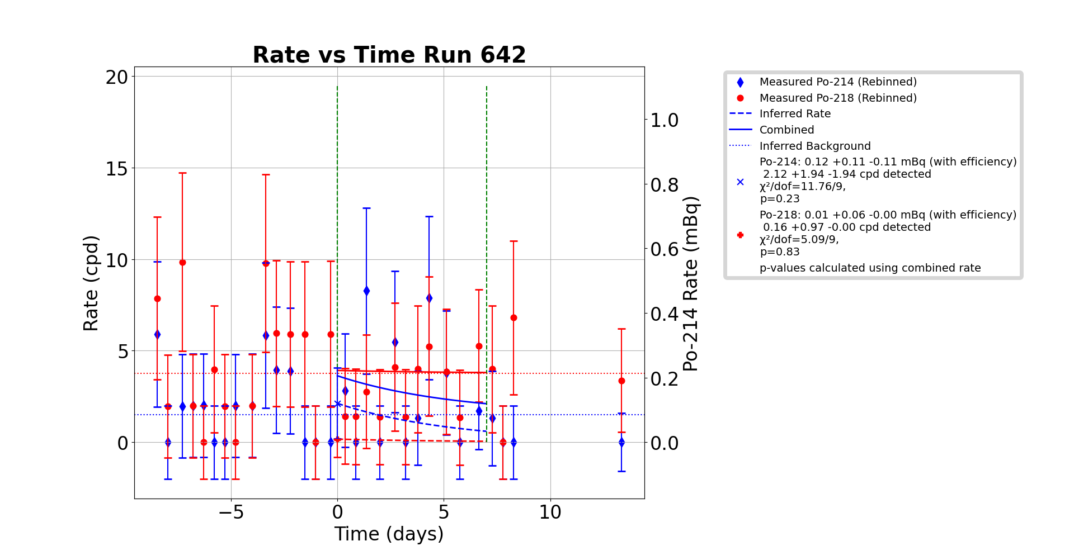
Third Emanation (Nov. 20 – Dec. 4)
Emanated at 99.6 Torr. This is high enough to include recoil emanation from all surfaces.
Due to probable overlap between Po-210 and Po-218 measurements, analysis and rate are based off of Po-214 counts
Po-214 counts indicate a rate of
A large portion of the data from Post-Background Run 643 was deemed unusable because a decrease in gain caused the Po-210 counts to become indistinguishable from Low-Energy background noise.

Slide 7
Conclusion
The sample emanates at a rate of 0.11 ± 0.1 mBq

Slide 8
Backup Slides

Slide 9
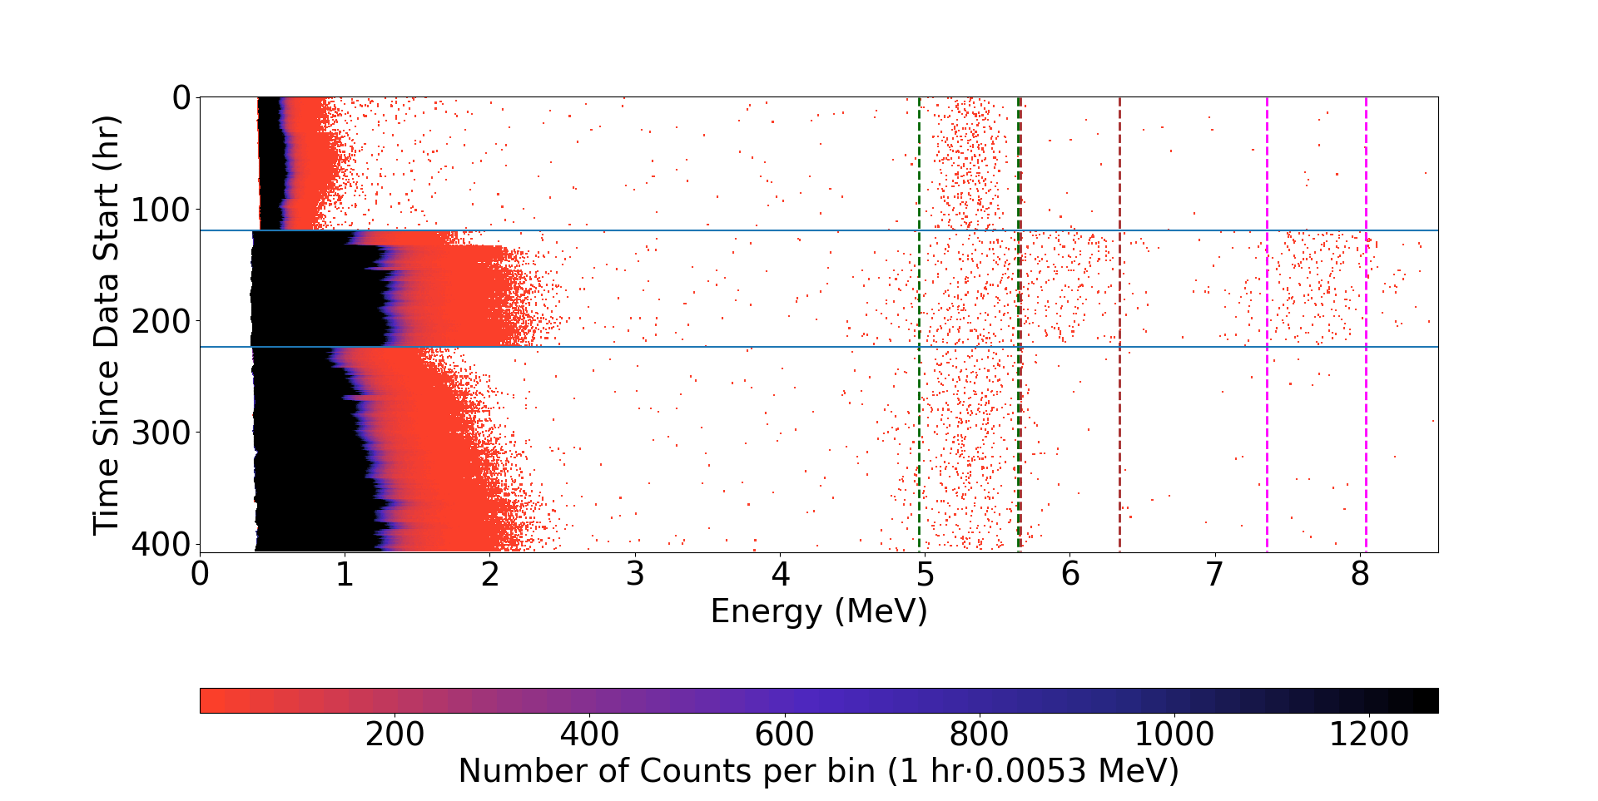
First Transfer
Po-210
Po-218
Po-214
Background
Sample
Background

Slide 10
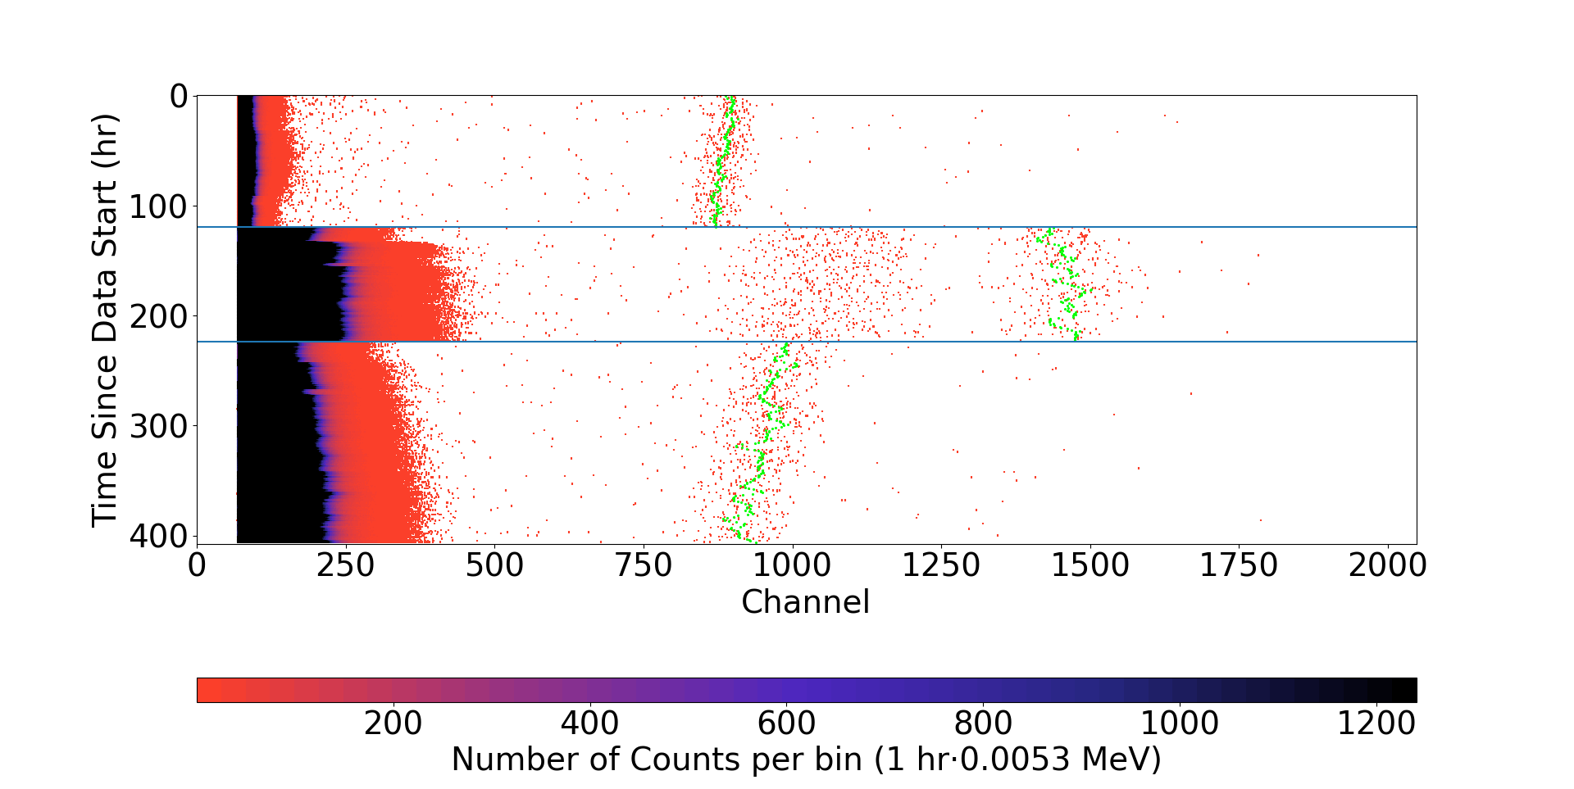
First Transfer
Time vs. Energy, Before Gain Correction

Slide 11
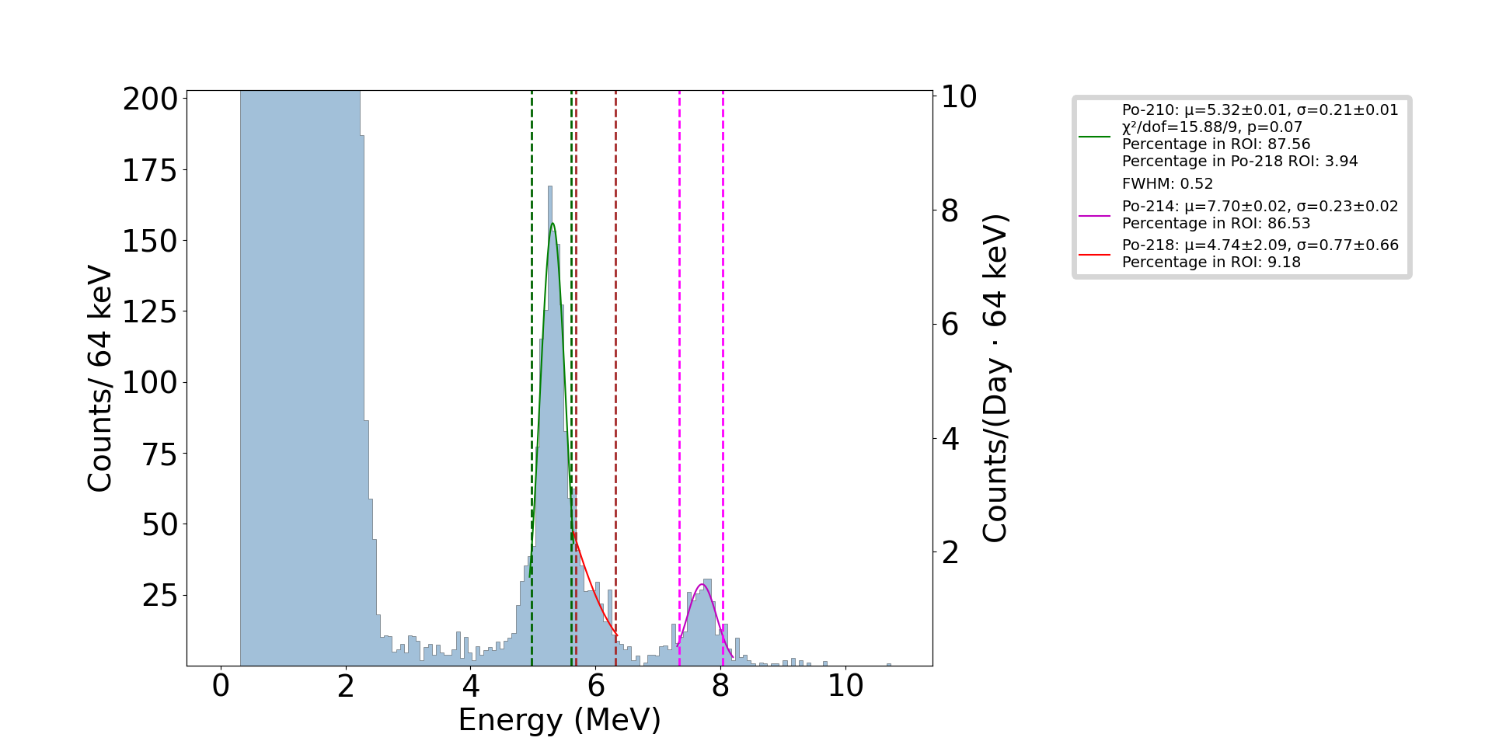
Cumulative Counts vs. Energy, First Transfer

Slide 12
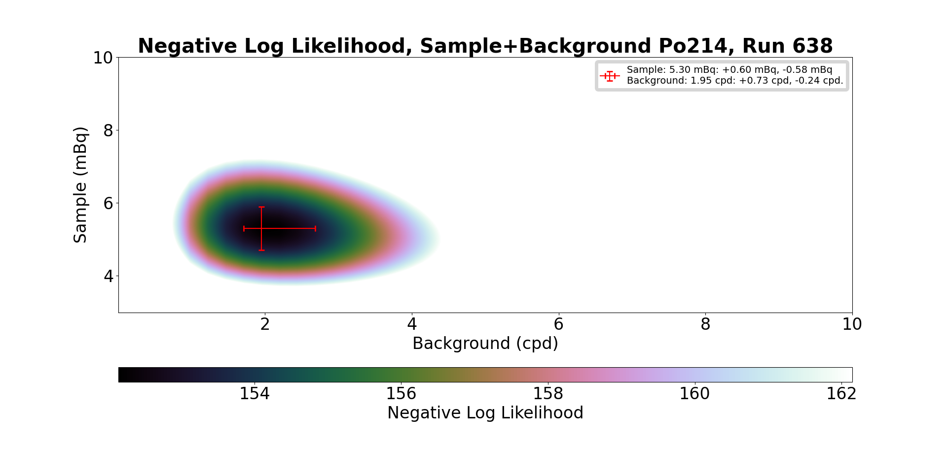
Negative Log Likelihood, First Transfer, Po-214

Slide 13
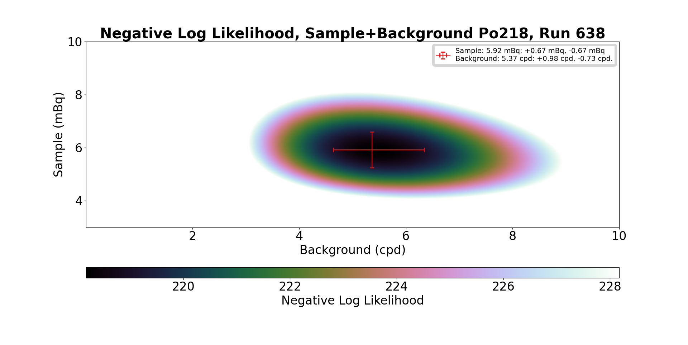
Negative Log Likelihood, First Transfer, Po-218

Slide 14
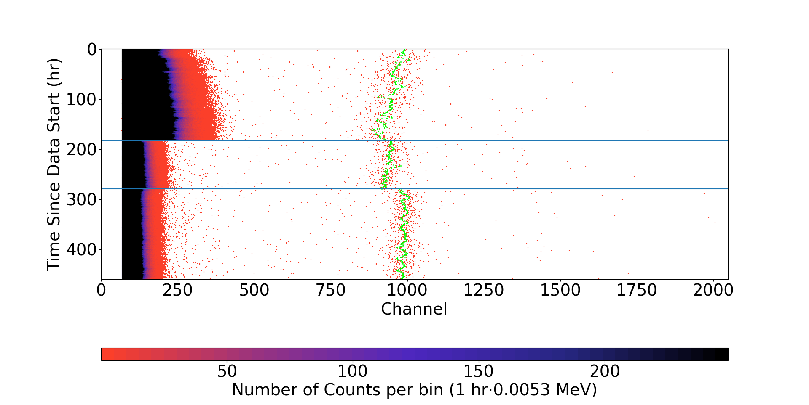
Second Transfer
Time vs. Energy, Before Gain Correction

Slide 15
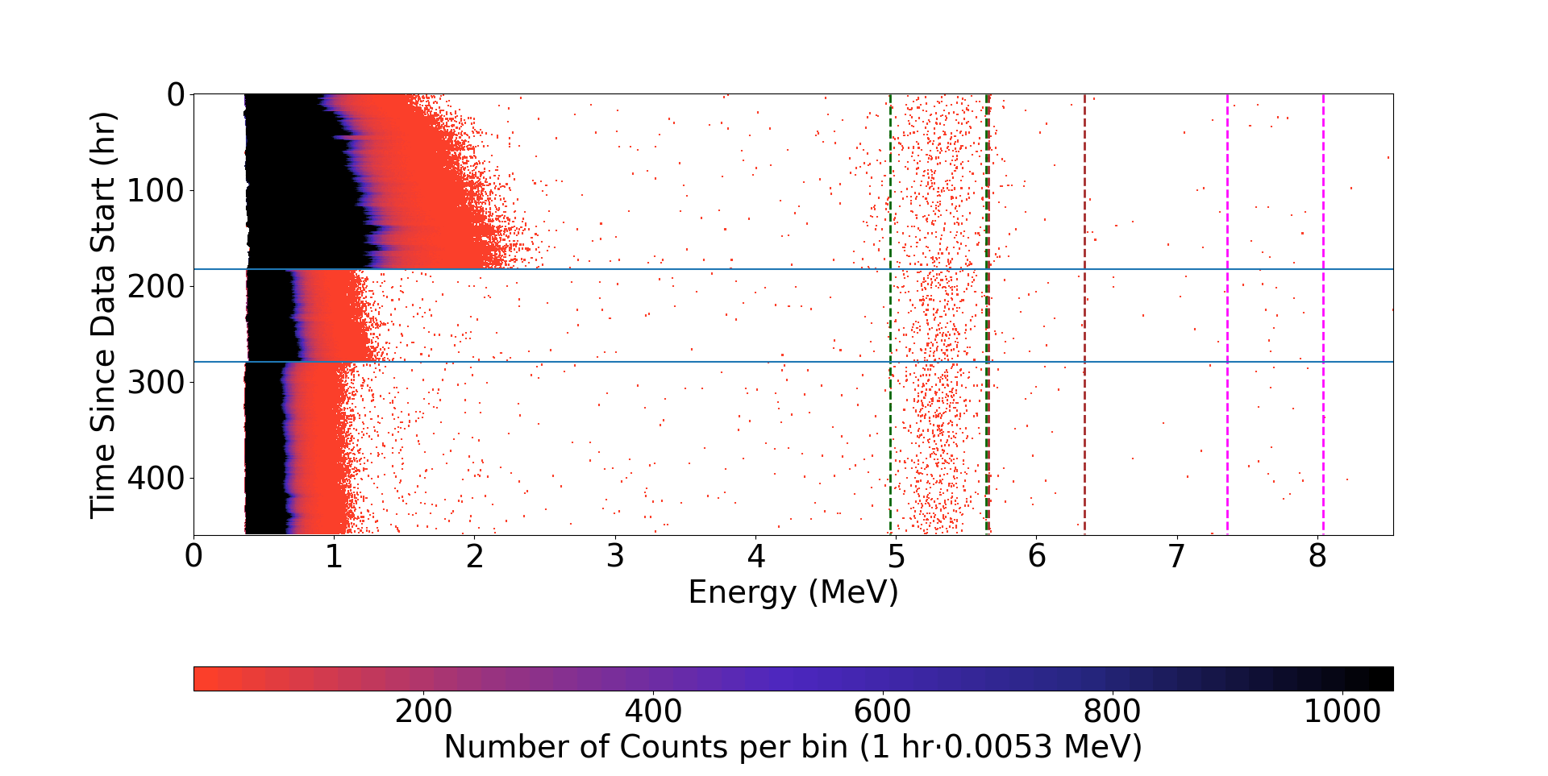
Second Transfer

Slide 16
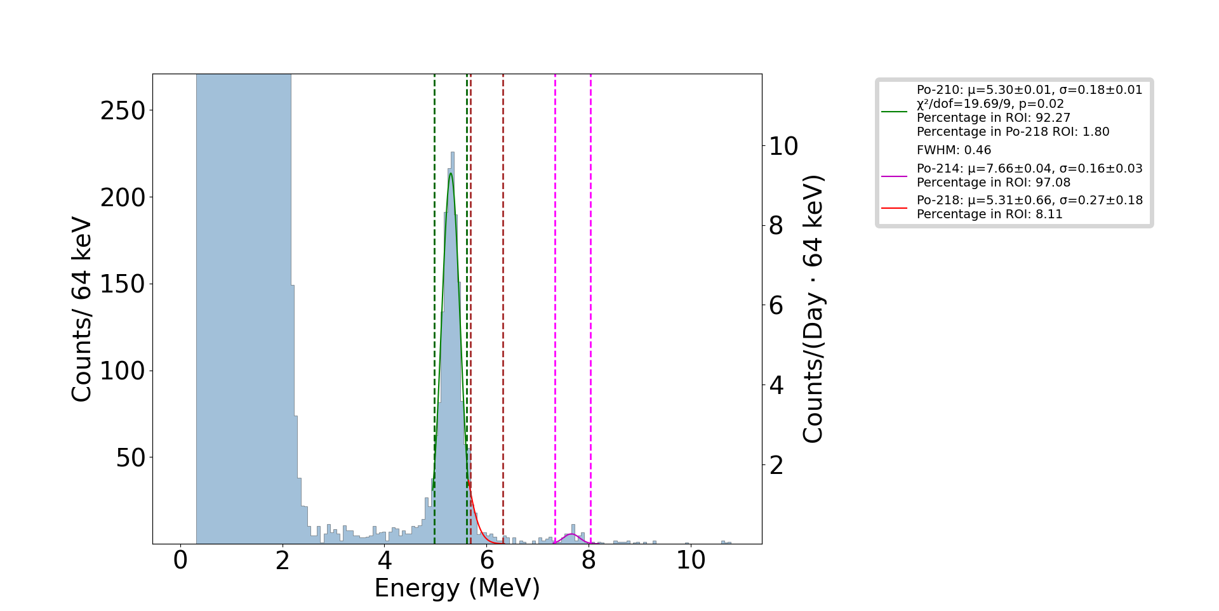
Cumulative Counts vs. Energy, Second Transfer

Slide 17
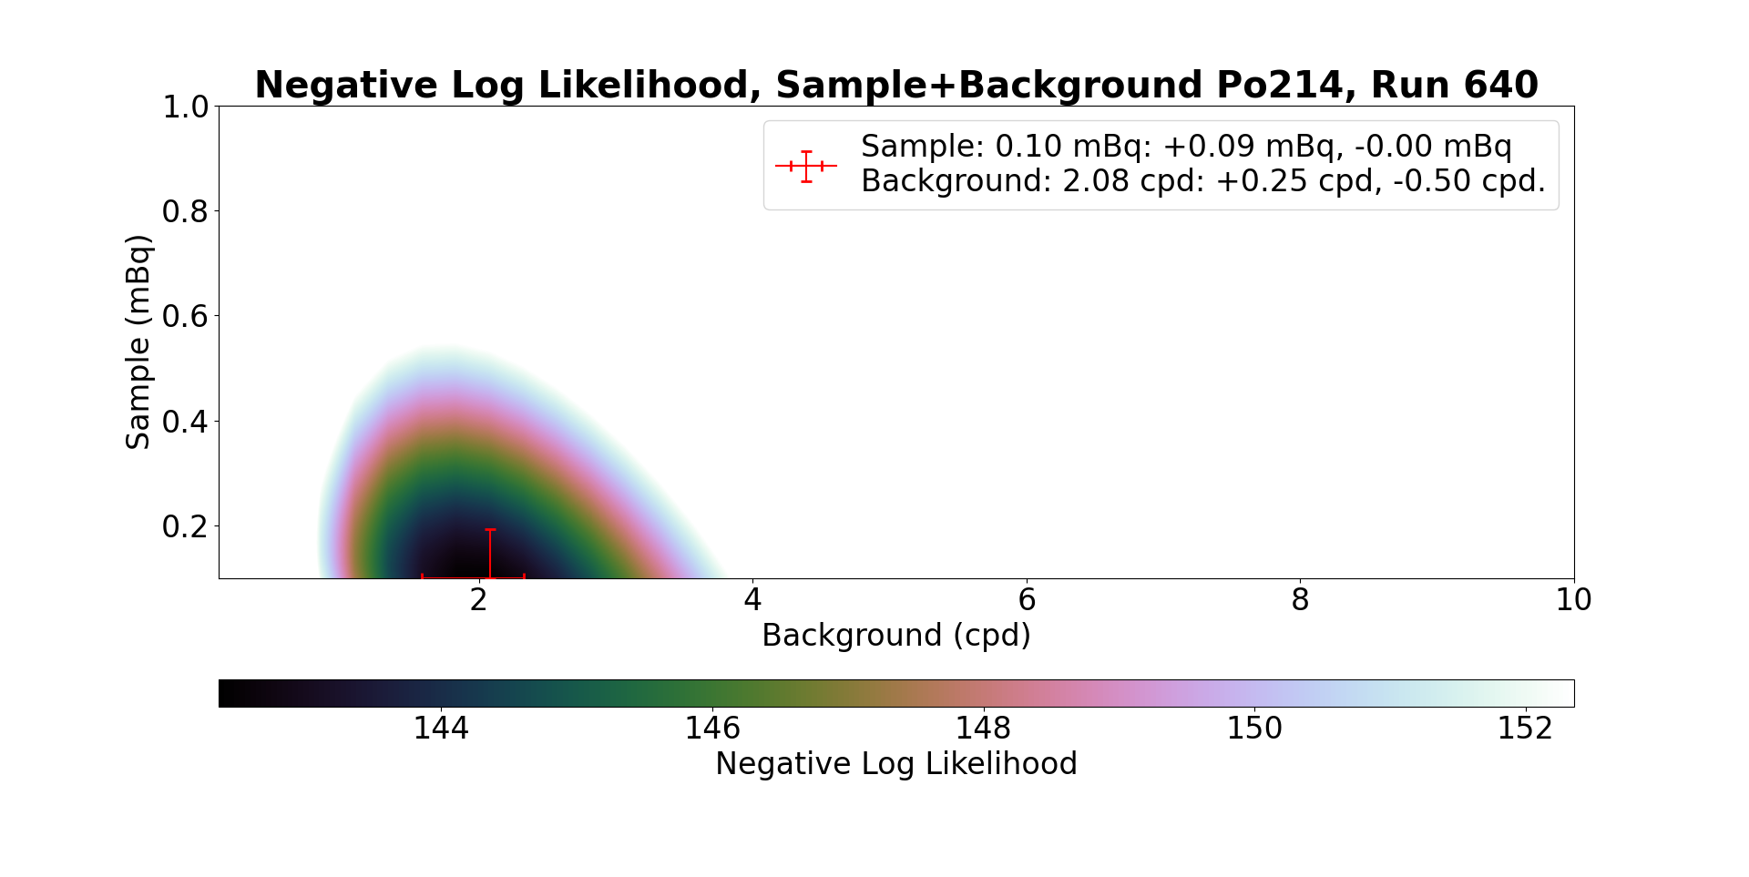
Negative Log Likelihood, Second Transfer, Po-218

Slide 18
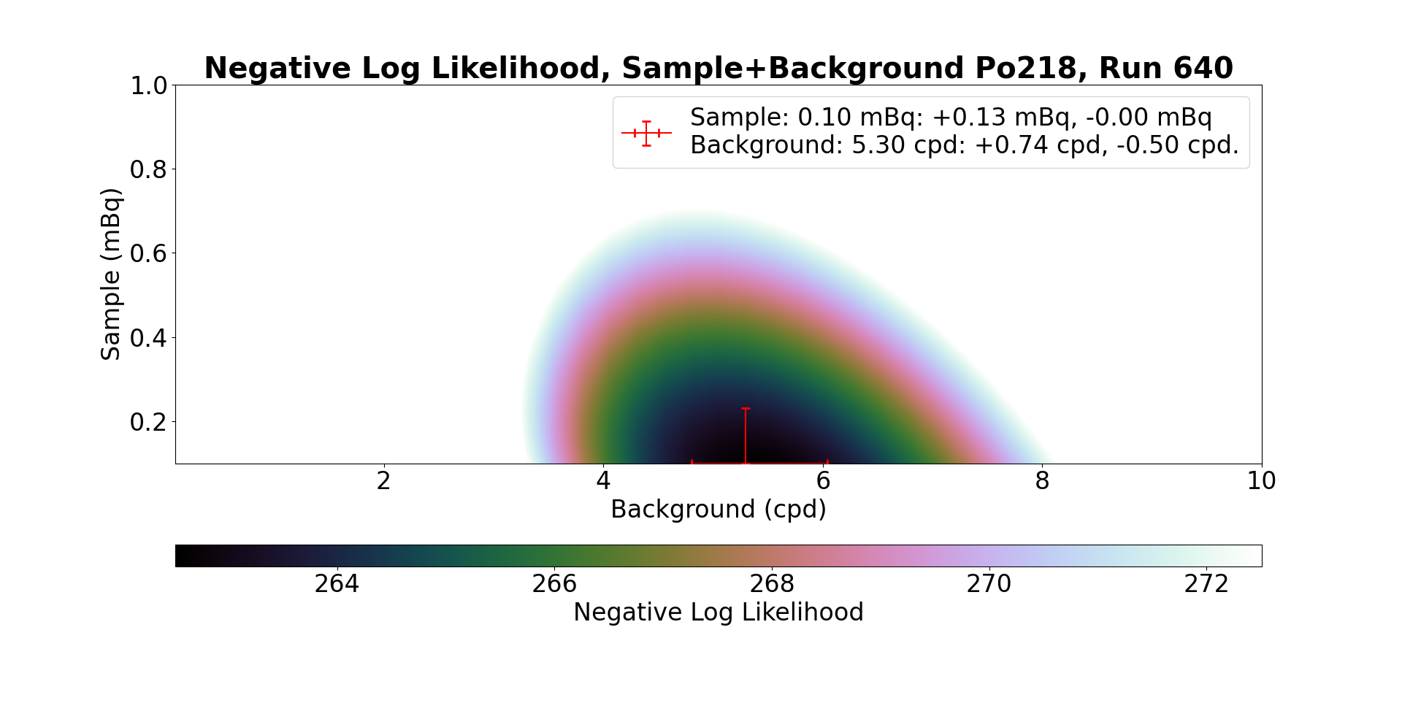
Negative Log Likelihood, Second Transfer, Po-218

Slide 19
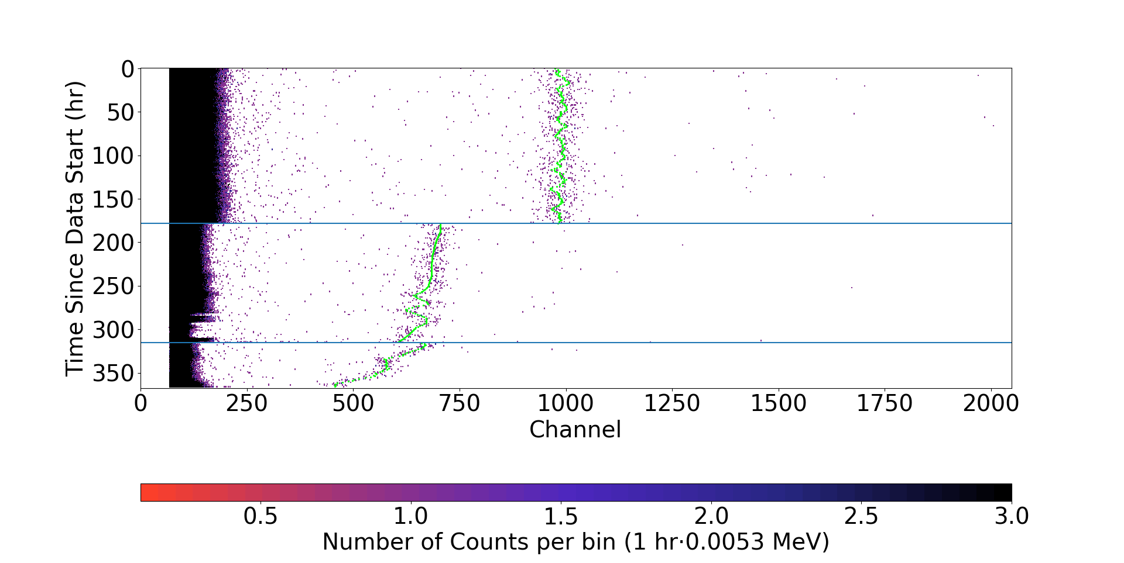
Third Transfer

Slide 20
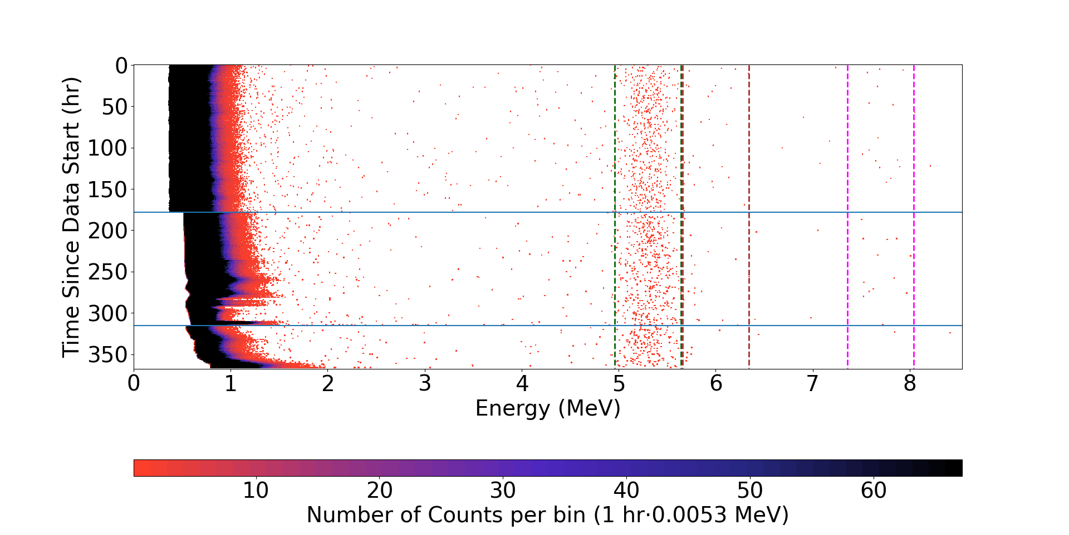
Third Transfer

Slide 21
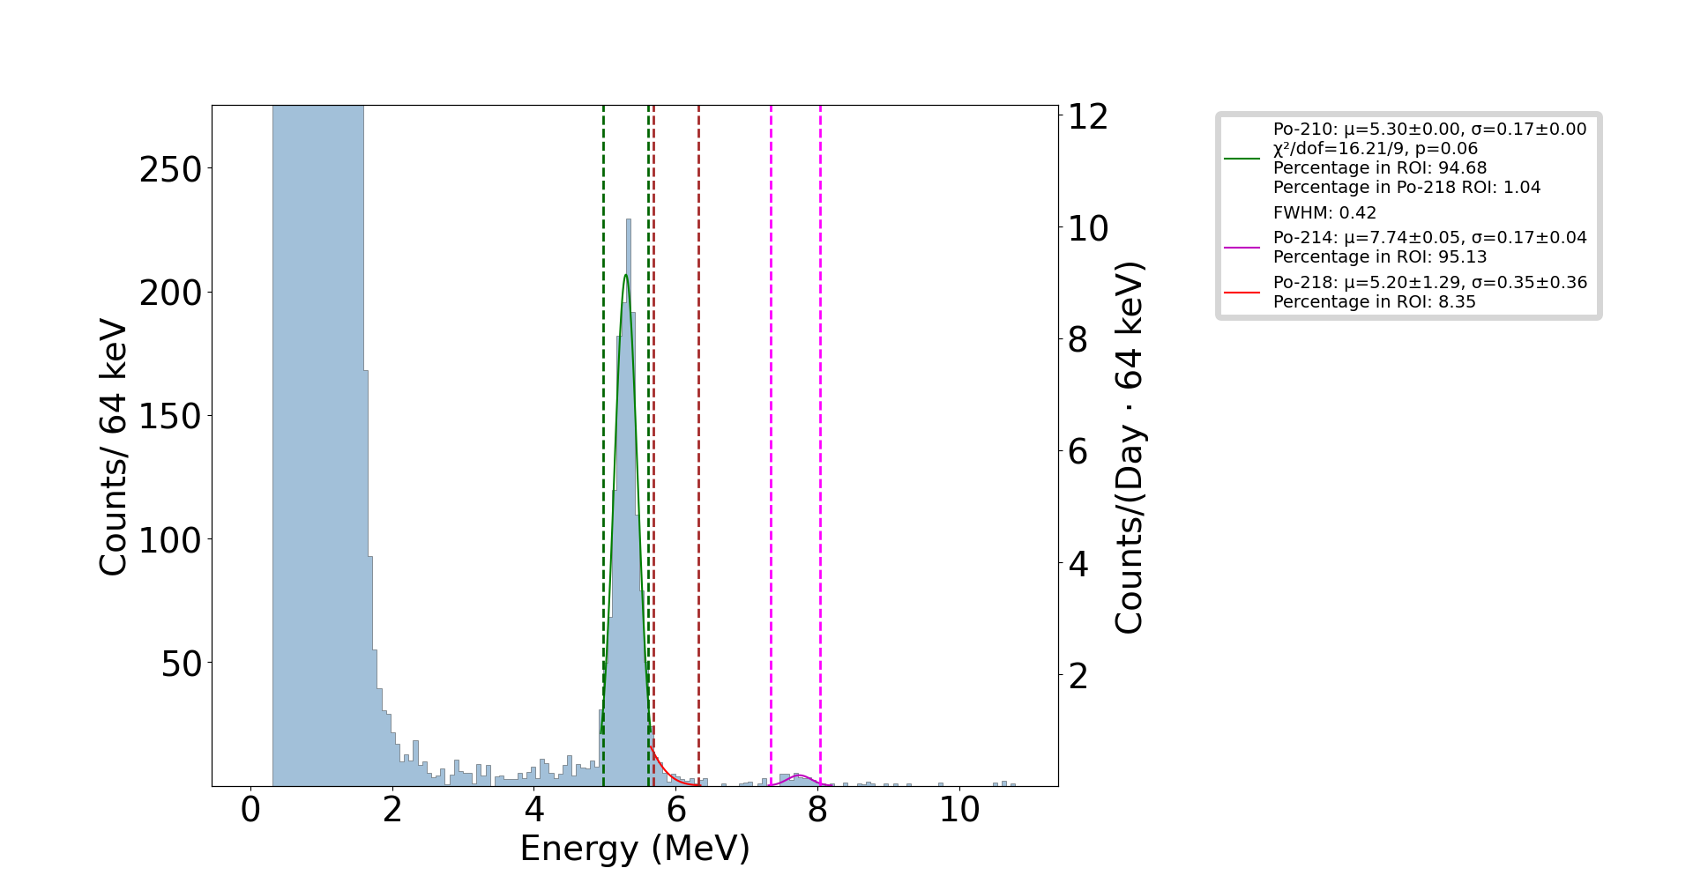
Cumulative Counts vs. Energy, Third Transfer

Slide 22
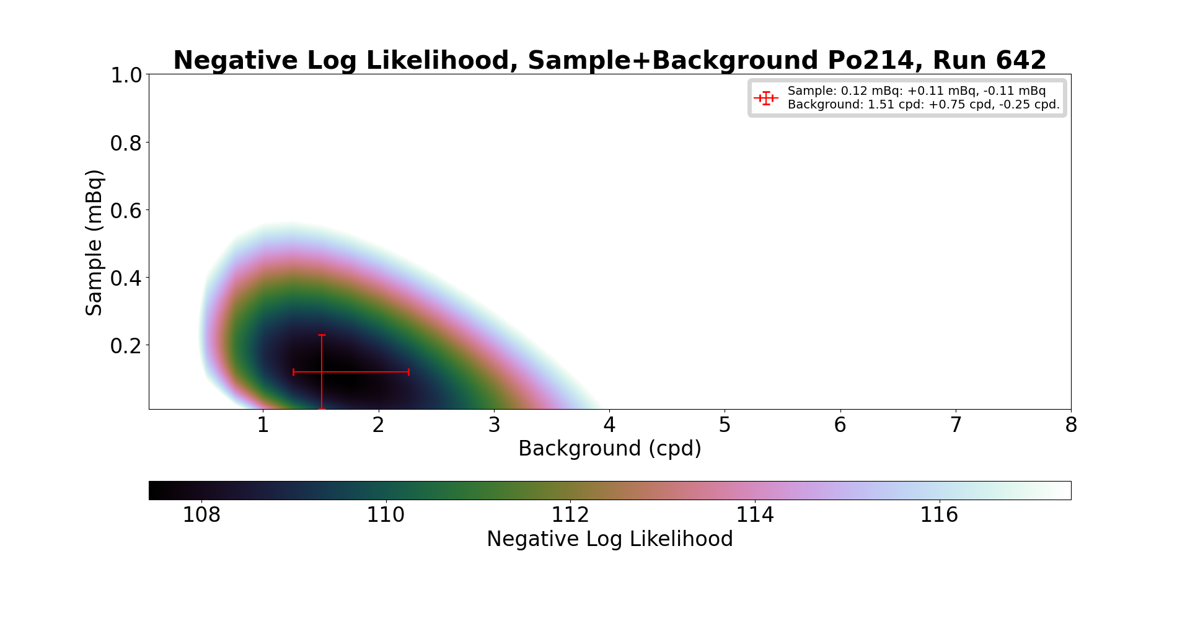
Negative Log Likelihood, Third Transfer, Po-214

Slide 23
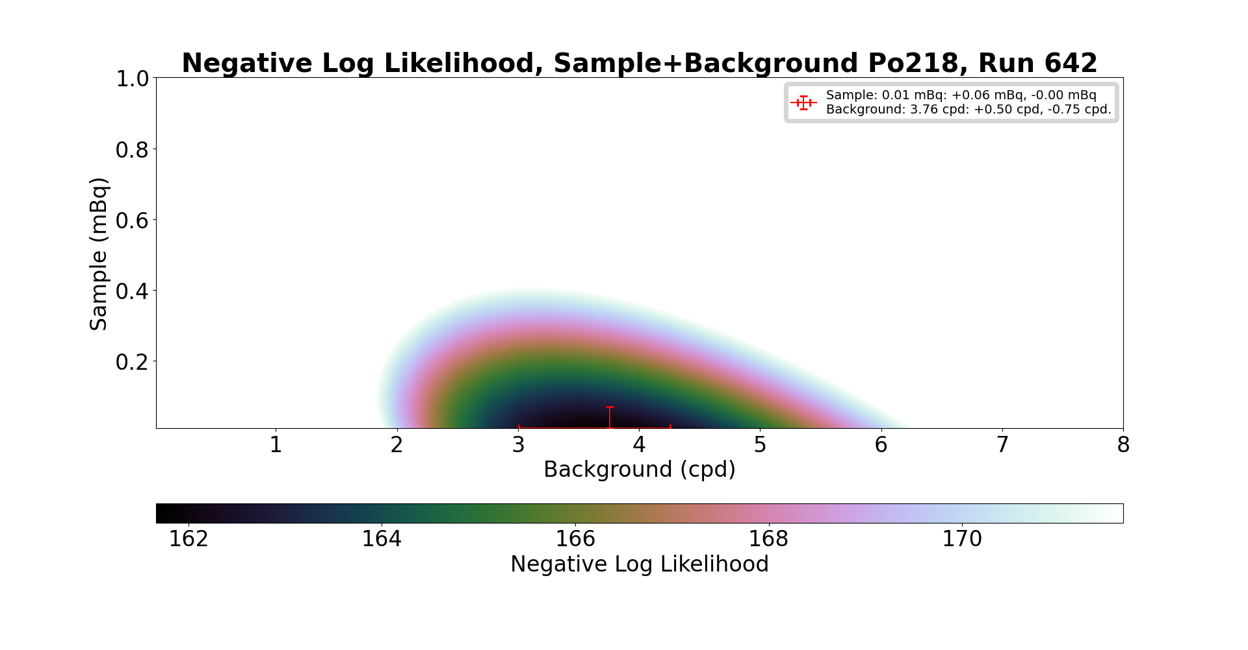
Negative Log Likelihood, Third Transfer, Po-218

